Slide 1





Go Auto
Vehicle mileage group classification
- Ml Champs

Slide 2





Go Auto
Go Auto is a leading Canadian automotive dealership network specializing in the sale and servicing of new and used vehicles, RVs, and related automotive solutions. In addition to vehicle sales, the company provides a comprehensive suite of services, including financing, insurance, and collision repair, ensuring a seamless and customer-centric automotive experience.

Slide 3
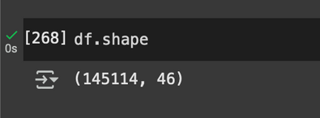
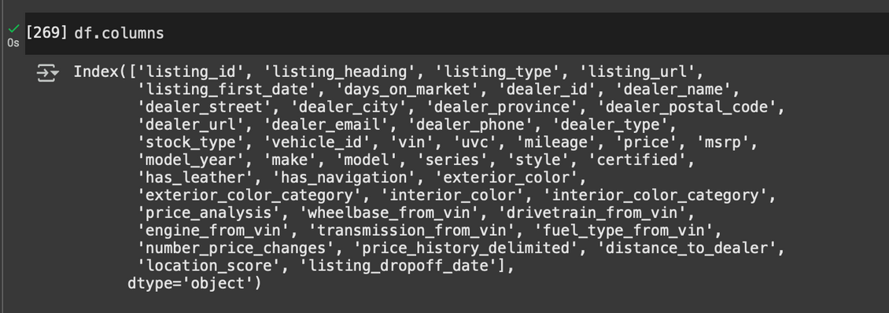

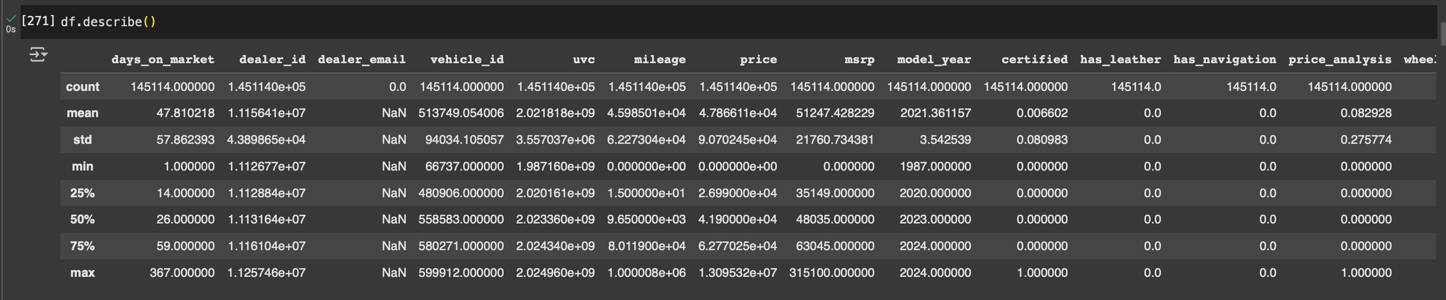
Basic Exploratory Data Analysis
Columns
Dimensions
Data types
Basic mathematical operations

Slide 4
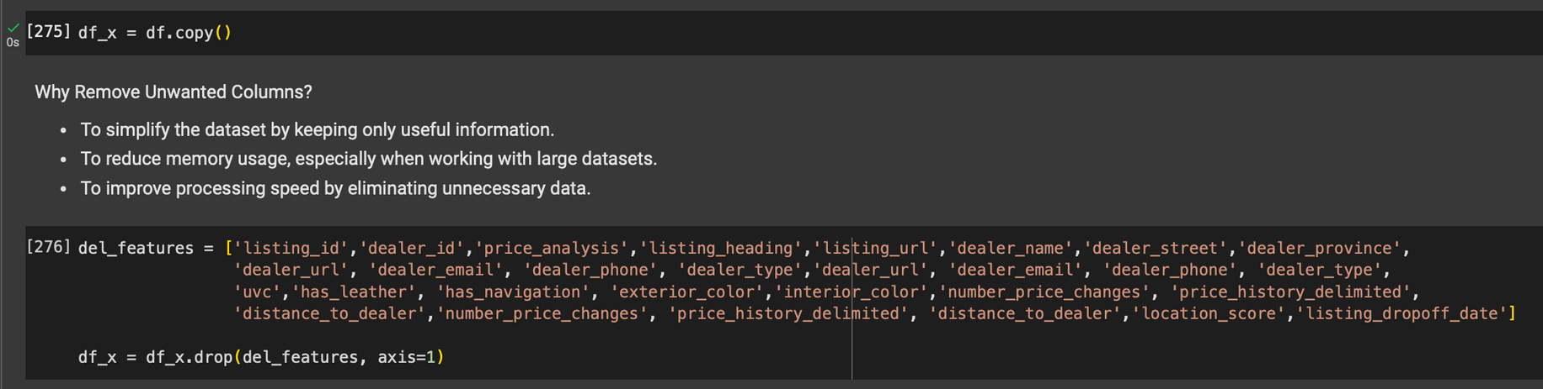
Feature selection
why did we choose these Features of data?
Researched for related factors of mileage
Logical dependent specifications of vehicles

Slide 5
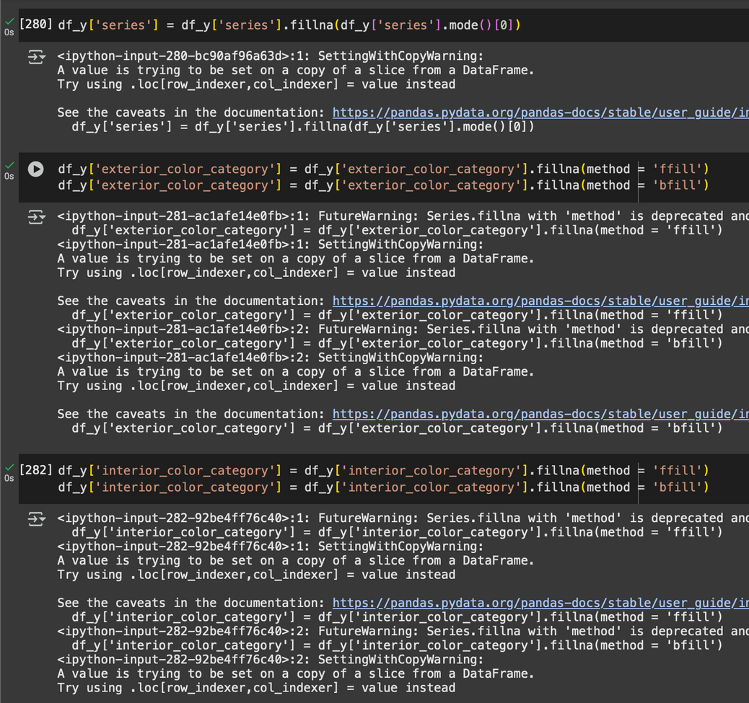

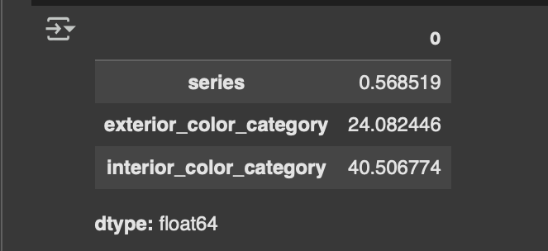
Handling Missing Values
LOCF (last observation carried forward) and NOCB (Next observation carried backward)
Why LOCF (last observation carried forward) and NOCB (Next observation carried backward)?
High percentage of missing values

Slide 6
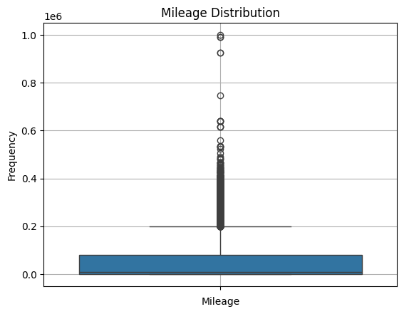
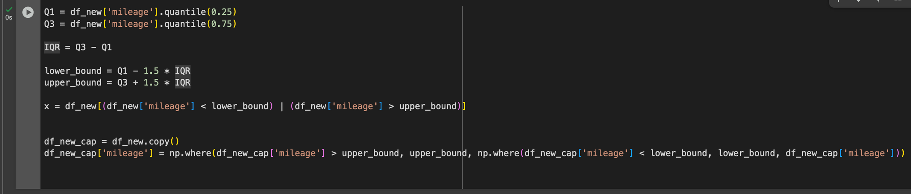
Handling Outliers
IQR (Inter quartile method)
replaced by Capping

Slide 7
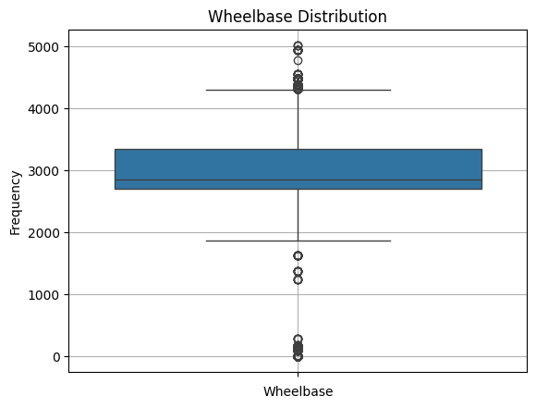
Handling Outliers (exception)
lower bound (minimum available)
upper bound (maximum available)
replaced by Capping

Slide 8
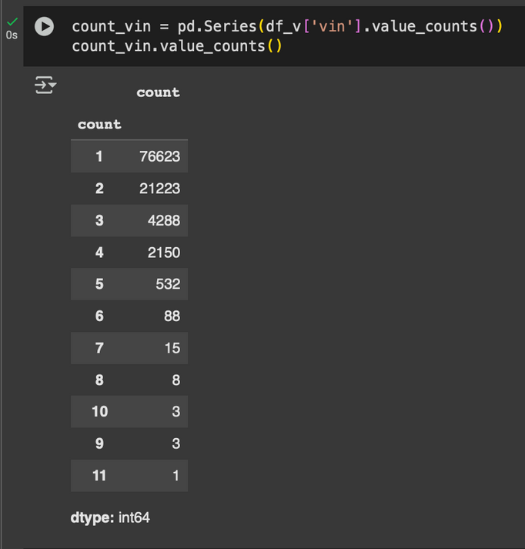
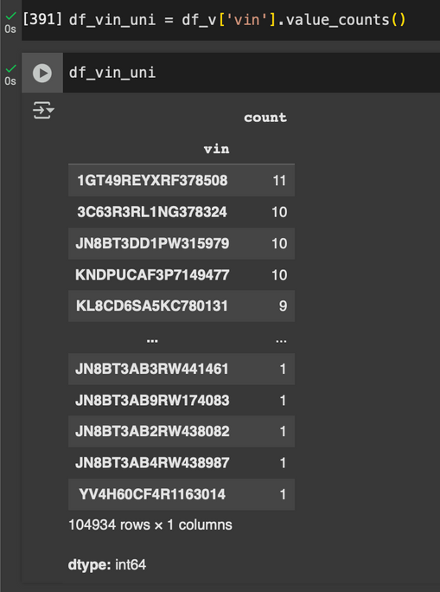
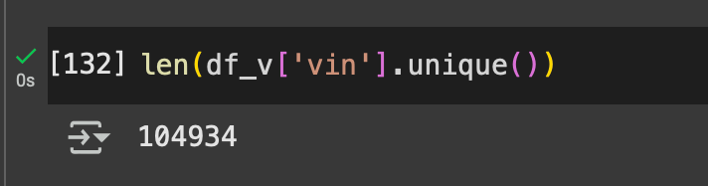
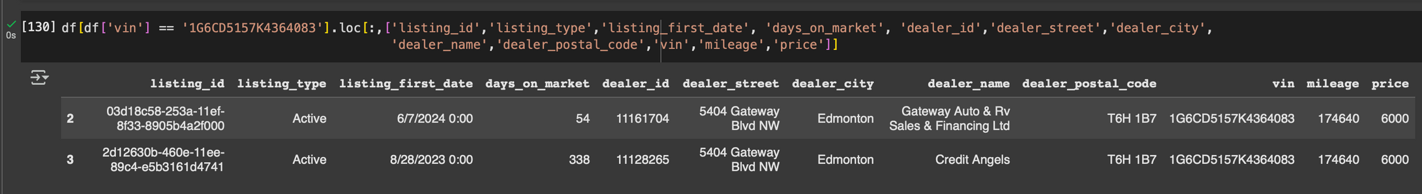
Eye catching points
Total Rows = 145114
unique vin = 104934

Slide 9



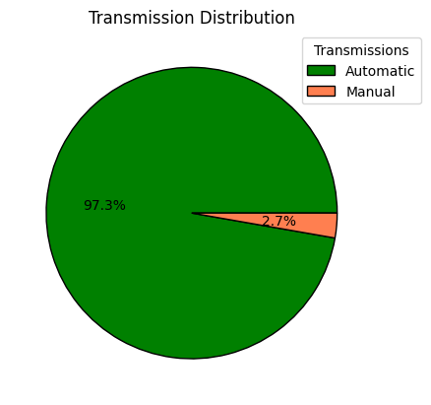
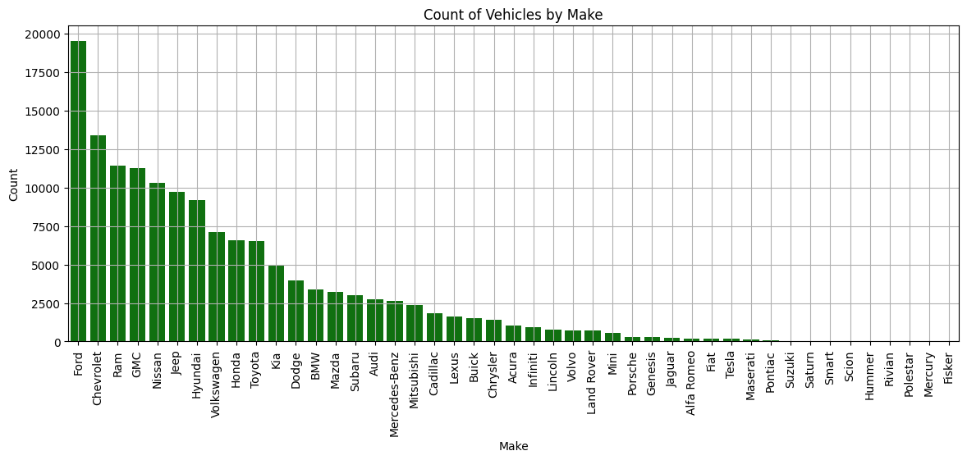
Univariate analysis
Analysis on each column separately
Transmission
distribution
Count by Make

Slide 10
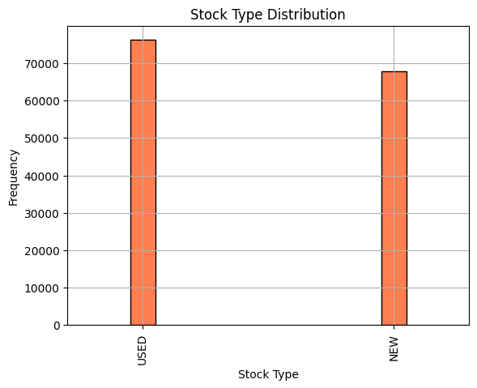
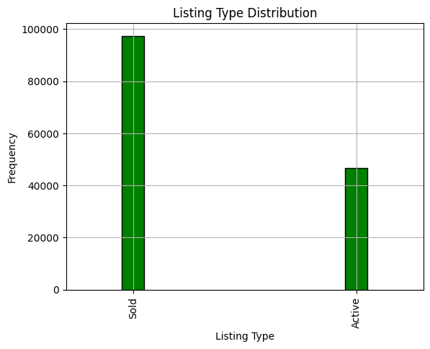
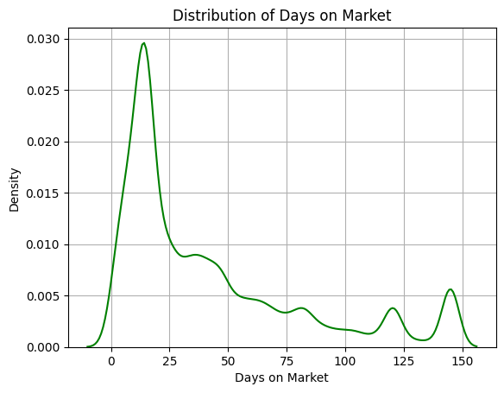
Univariate analysis
Stock Type
Count of number of days
Listing type

Slide 11
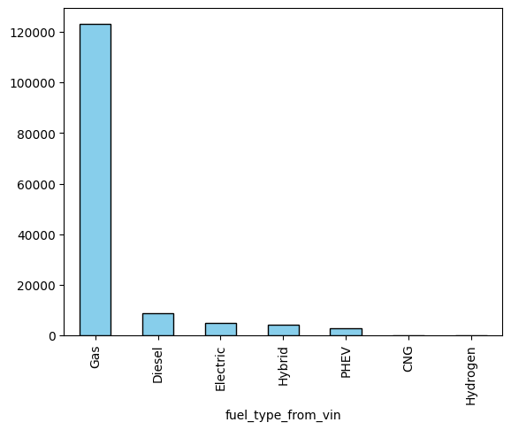
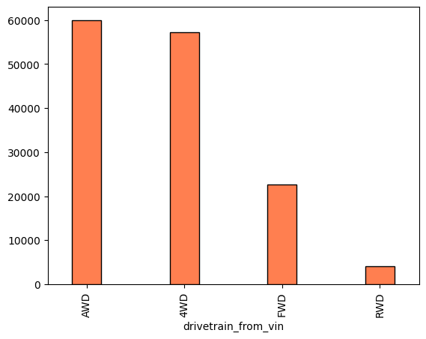
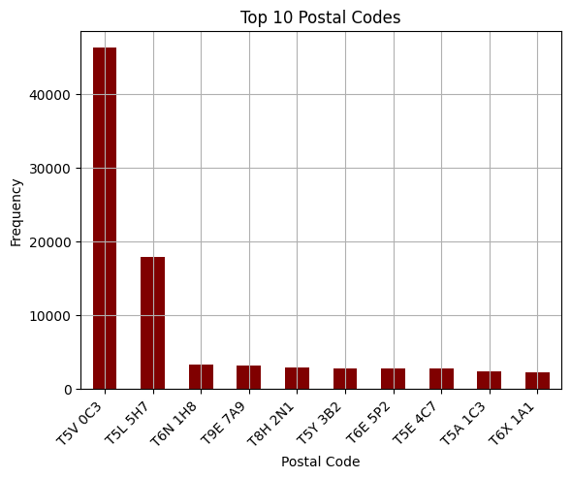
Univariate analysis
Count by fuel type
Count by drivetrain
Top 10 count of listings
by postal codes

Slide 12

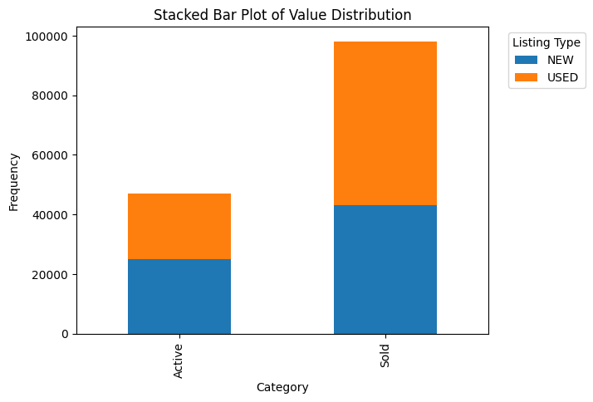

Listing type and Stock type
Listing type
Stock Type
Sold > Active
New ~= Old

Slide 13

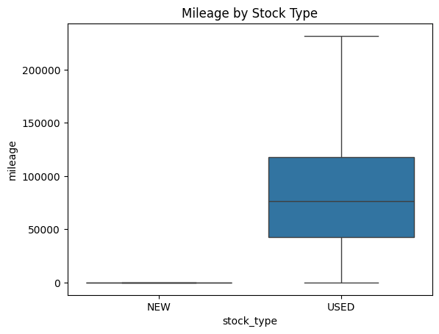
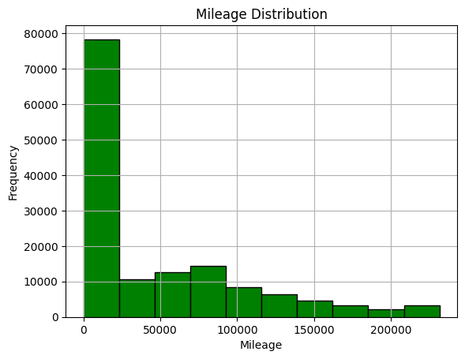

Mileage classification
low mileage -> high count

Slide 14

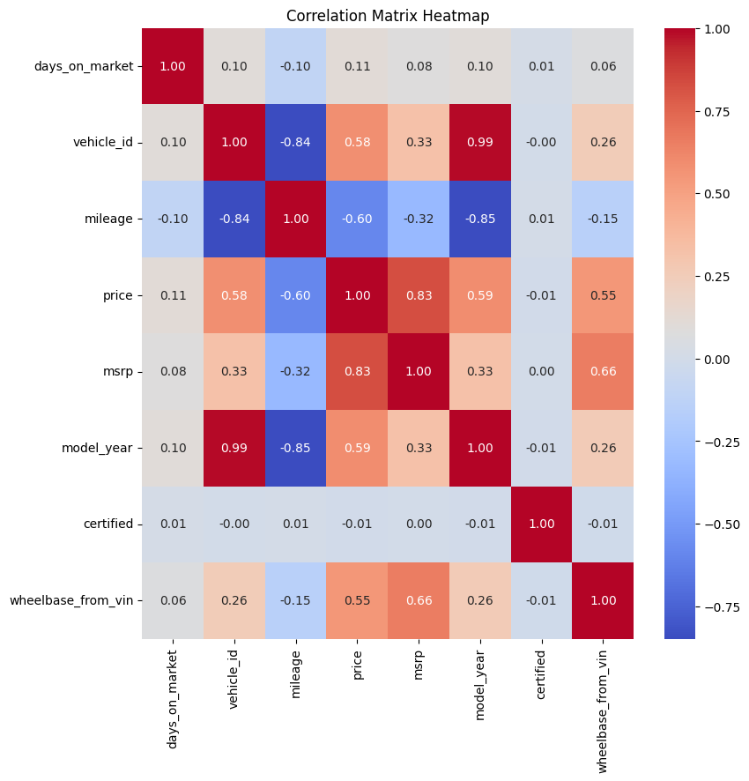

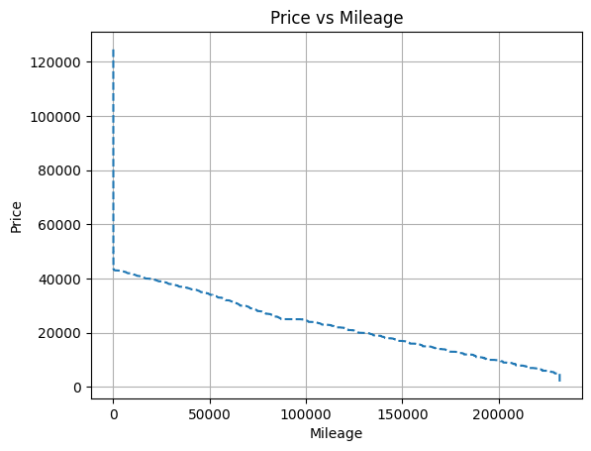

The co-relation of mileage with other features
Price Increase -> mileage decrease
model year decreases -> mileage increase

Slide 15
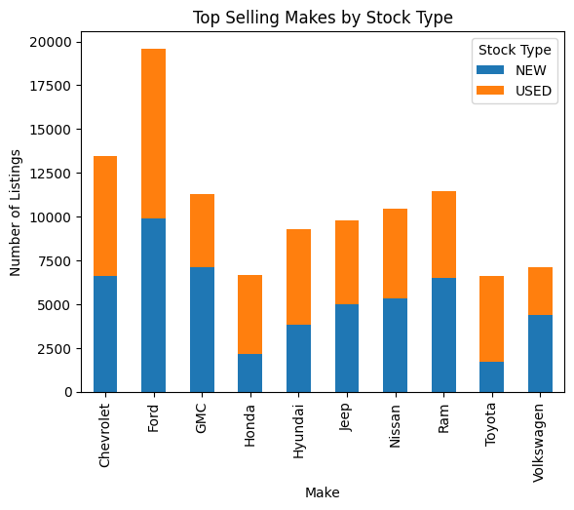
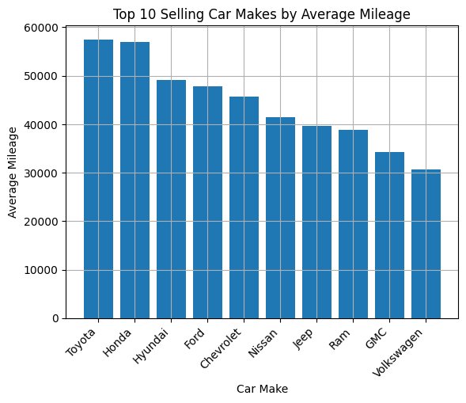
Top 10 makes by average mileage
Average Mileage of Toyota and
Honda vehicles are highest

Slide 16
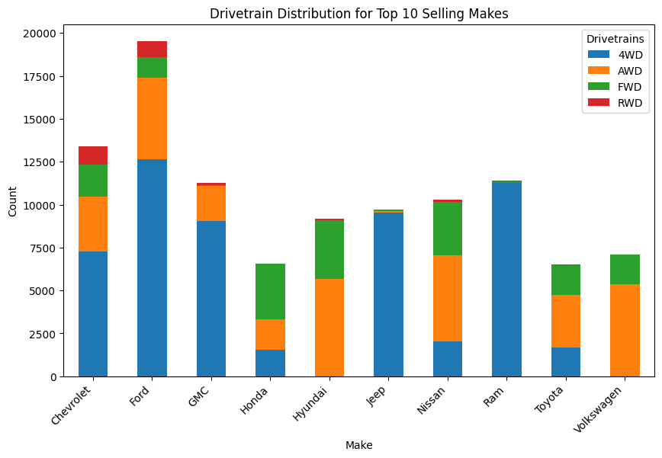
Make and drivetrain count
Ram and jeep have almost
all cars 4WD

Slide 17


Proposal for clustering Model
Problem statement #5: Best selling Regions
Our team, ML Champs aims to develop a cluster model to identify the best performing regions. Once the region is determined, we will apply a classification model to predict the mileage group of vehicles within those regions.

Slide 18
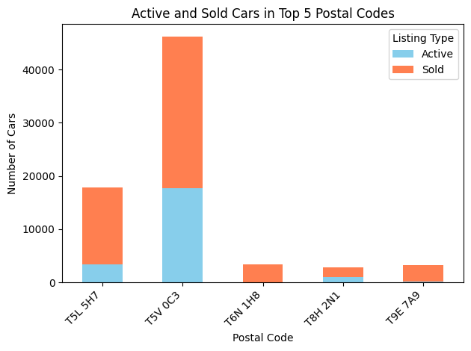
Most selling region
Although number of listings is high in T5V 0C3, still ratio of sold and active vehicle is more in T5L 5H7

Slide 19
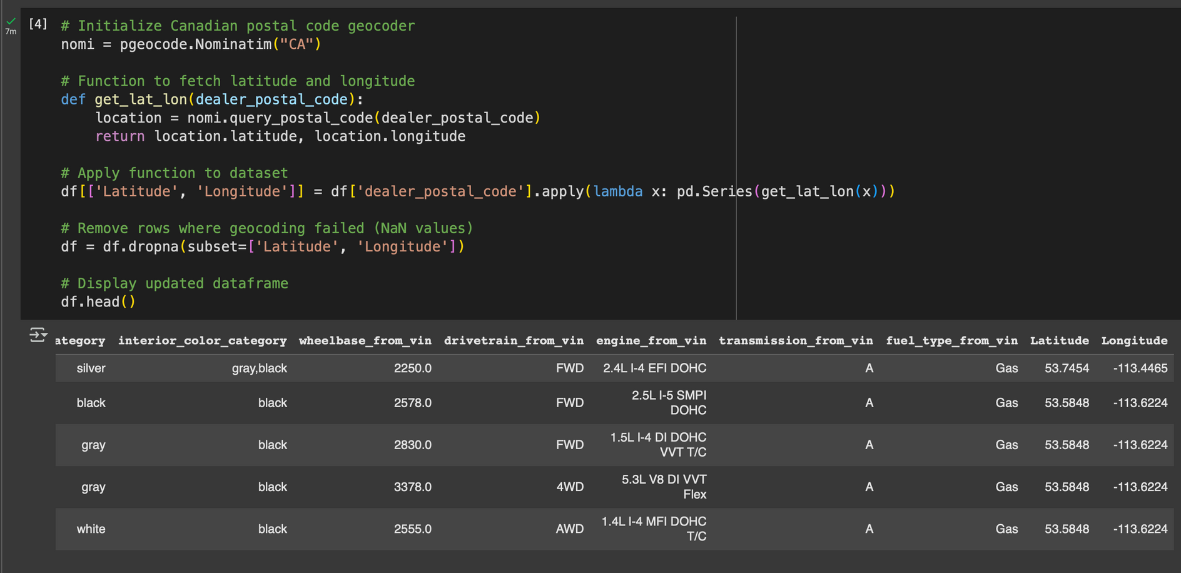
Generated longitudes and latitudes from postal codes

Slide 20
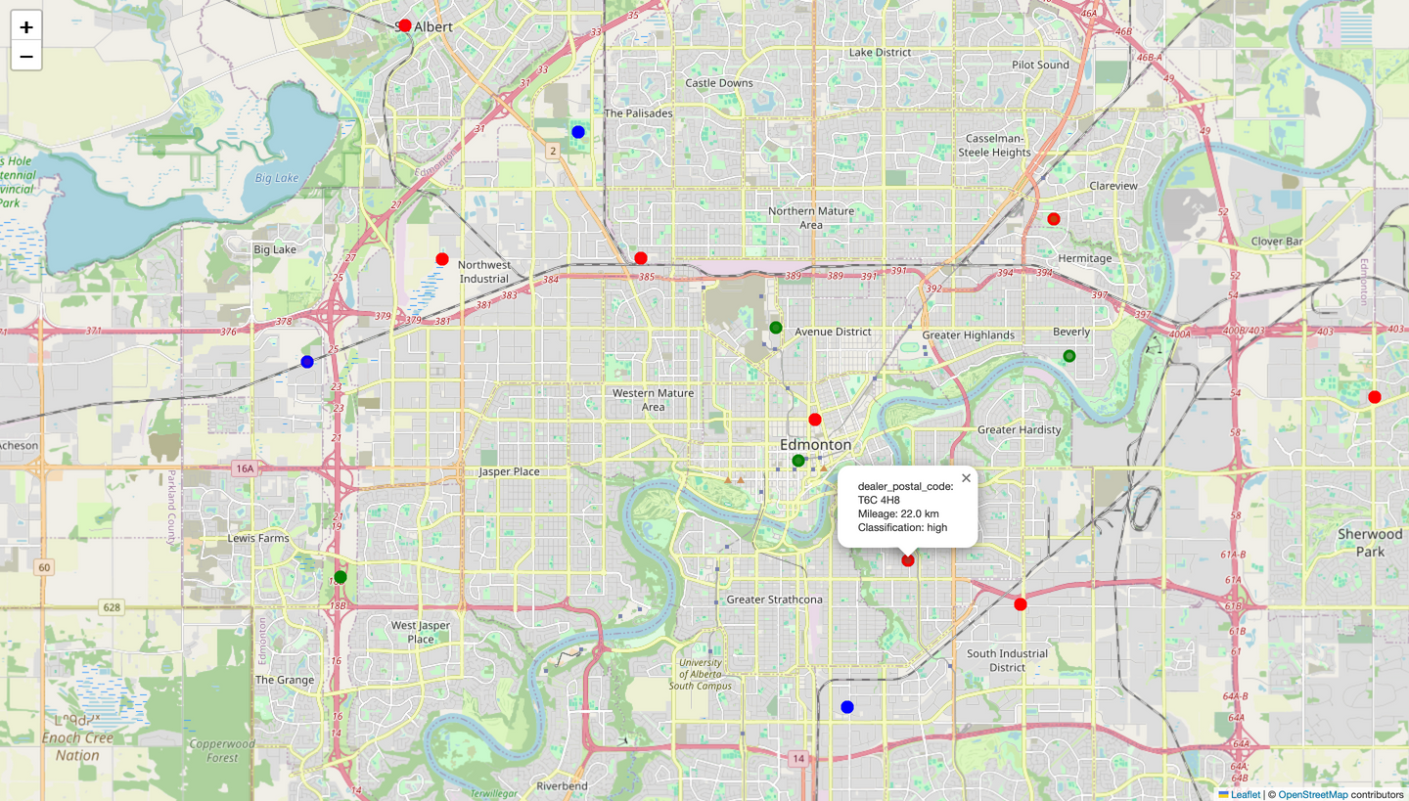
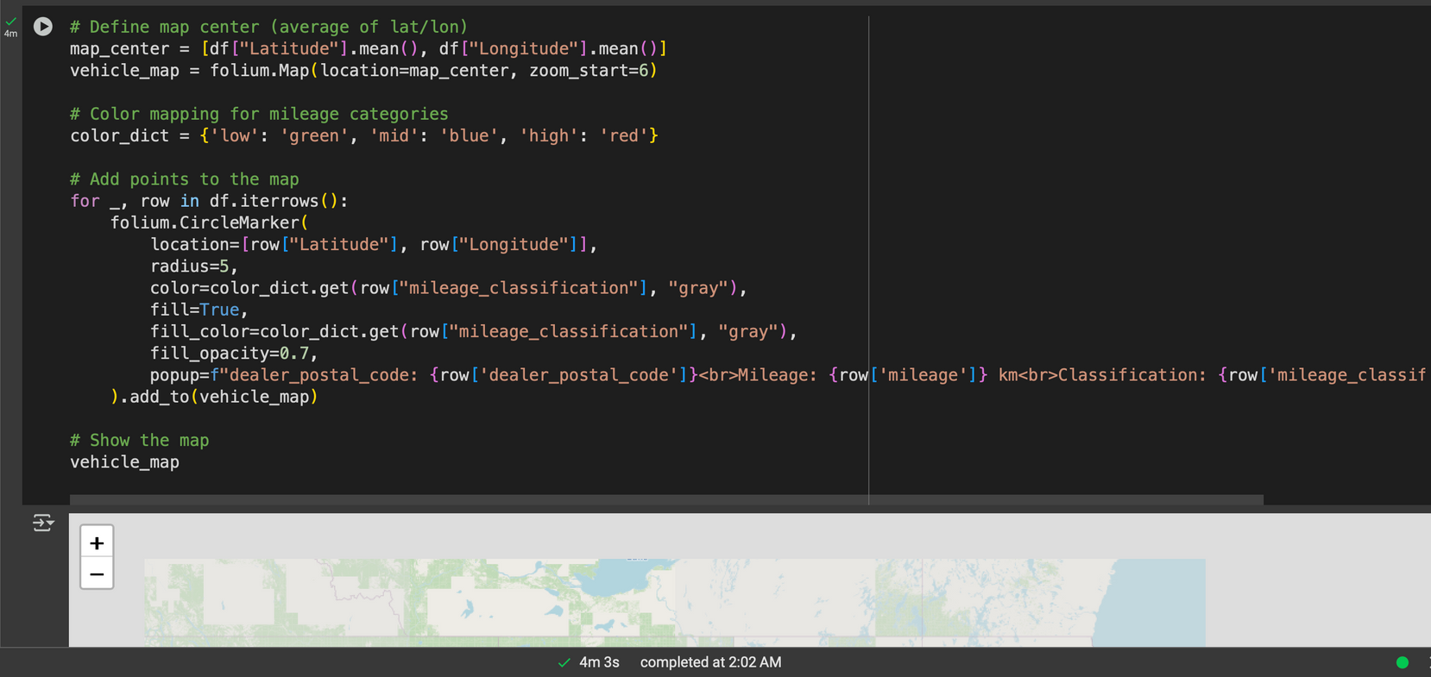
Generated a map from longitudes and latitudes
🟢 Green → Low Mileage (Below 33rd percentile)
🔵 Blue → Mid Mileage (Between 33rd and 66th percentile)
🔴 Red → High Mileage (Above 66th percentile)
file:///Users/inderjeetsingh/Desktop/mileage_map%20(1).html
Link to open map

Slide 21
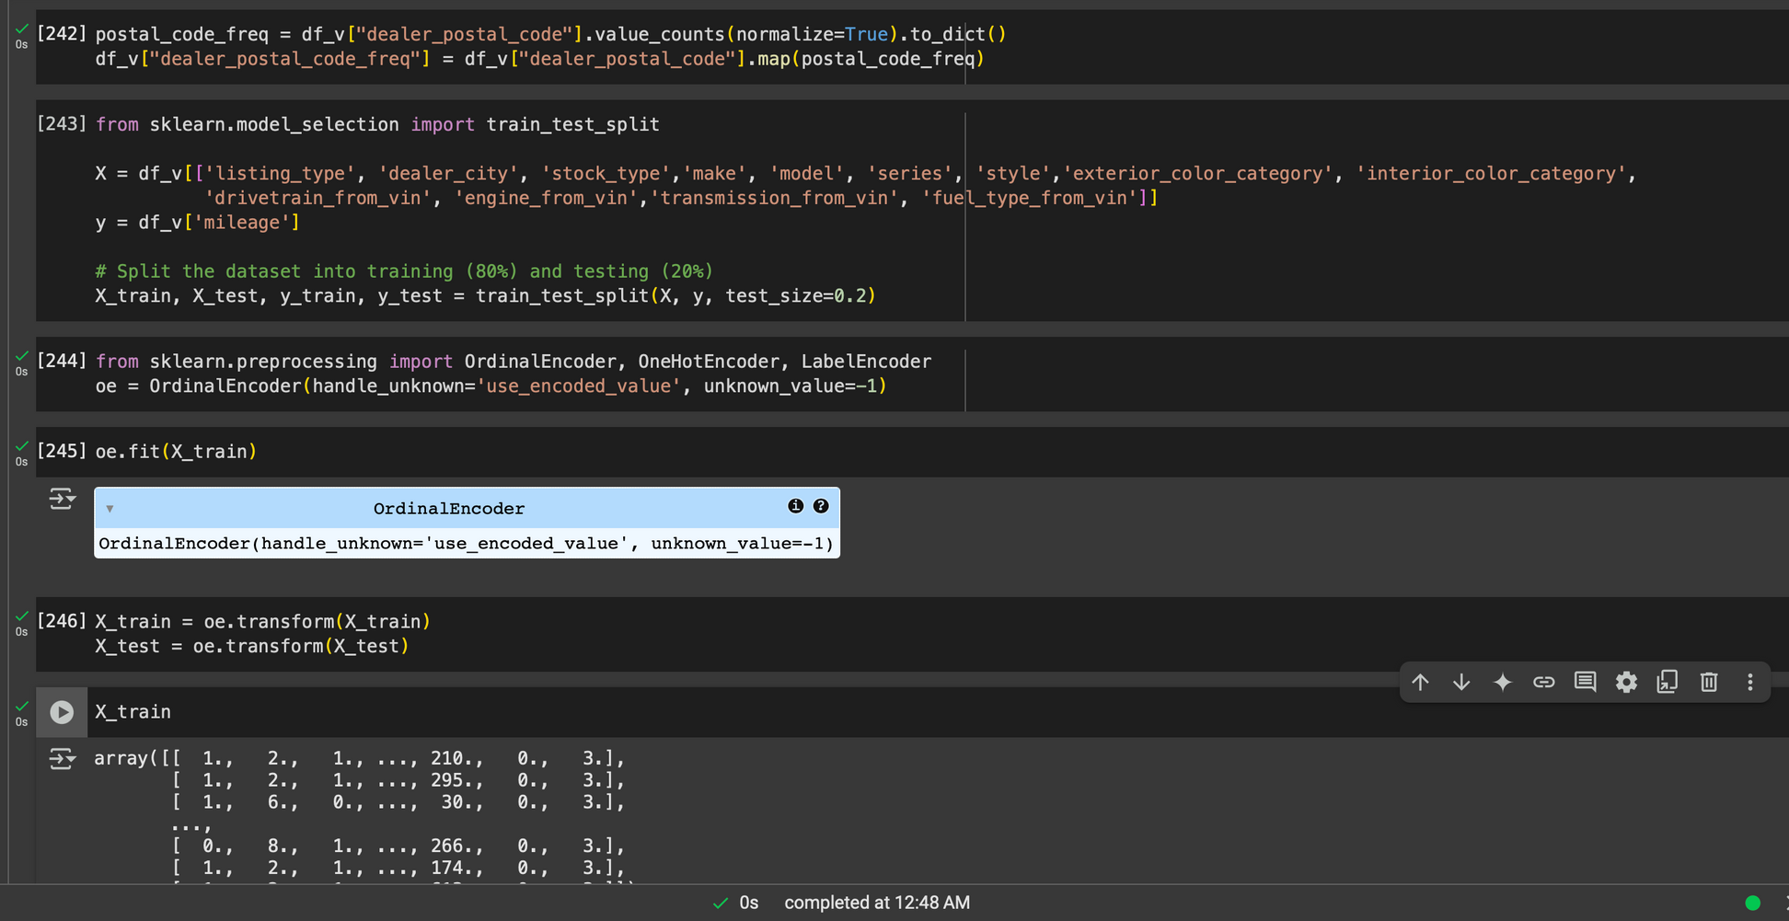
Data Encoding

Slide 22


- ML Champs

